Slide 1

AKS Office Hours
Kendall Roden
Cloud Native Technical Specialist
Kendal Roden
Cloud Native Technical Specialist
Dave Strebel
Cloud Native Technical Specialist

Slide 2

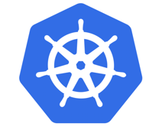


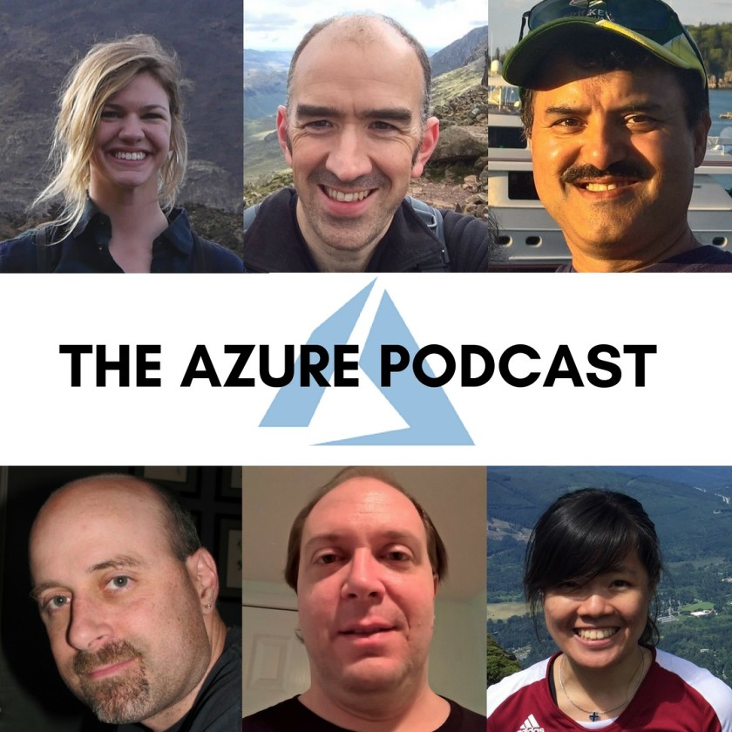


Who are we?
@kendallroden​
@dave_strebel​

Slide 3
Why AKS Office Hours?
Provide AKS customers with updates pertaining to AKS and the Cloud Native Ecosystem
Host a short talk and/or demo on Cloud Native technologies related to Kubernetes and AKS
Collect feedback from customers on issues, blockers, use cases, and questions related to AKS

Slide 4
What to expect
Call agenda
5-10 minutes: Welcome, followed by AKS and ecosystem updates
20-30 minutes: AGIC add-on with Cat Yao and Akshay Gupta
20-30 minutes: “Ask us anything” and customer feedback discussion
Keep in mind
We want two-way interaction, but please stay on mute when you are not speaking
Office hours are hosted primarily by the GBB team, with the support of the PG
Recordings and content will be available post-call, barring any technical difficulties
Contact us with thoughts, ideas or questions (aksofficehours@microsoft.com)

Slide 5

AKS Updates

Slide 6
AKS Updates
The Azure Kubernetes Service pod security policy (preview) feature will be retired on May 31st, 2021.
AKS now supports every CPU-based SKU dynamically. This means that every new CPU-based SKU is automatically supported by AKS so long they're not on the restrictions list.
AKS Cluster Auto-Scaler now exposes the max-node-provision-time and priority properties.
AKS now supports Custom Node Configuration in Public Preview.
AKS now supports Private Clusters created with no Private DNS zone, deferring all DNS to an enterprise-managed DNS server.
You can create a cluster like this by using --private-dns-zone none, and making sure your custom DNS server is on the cluster subnet and contains all necessary entries including the API server endpoint IP (you can add after the cluster is created).
Azure AD Pod Identity Add-on is now in public preview.
Kubernetes 1.20 Preview

Slide 7
Ecosystem Updates

Slide 8
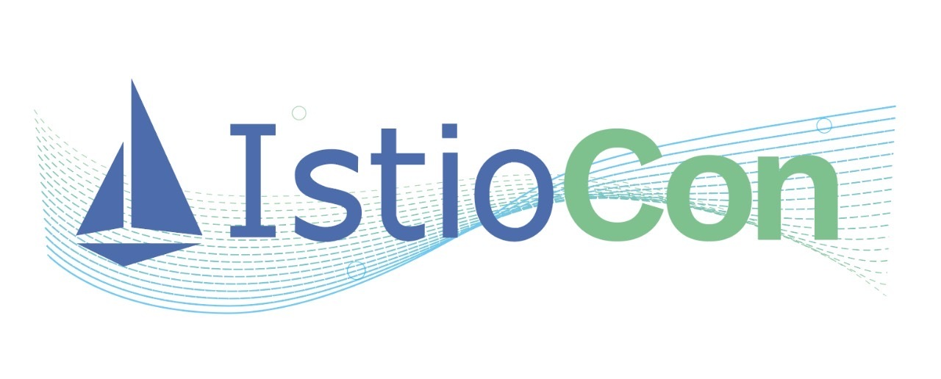

Ecosystem Updates
February 22-25, 2021
New Free Plan

Slide 9
Application Gateway Ingress Controller (AGIC)
AKS Office Hours – Cat Yao & Akshay Gupta

Slide 10
Agenda
Application Gateway Overview
AGIC Overview
AGIC Use Cases
Walkthrough – AGIC Add-On Greenfield Installation
Roadmap

Slide 11

Azure Application Gateway
Build secure, scalable, and highly available web applications in Azure
Platform managed
Built in high availability, zone redundancy, scalability
Public or ILB
Public internet, internal, or both
Static VIP
Flexible backends
VMs, VMSS, AKS, Public IP, Cloud Services, ALB/ILB, On-Premises
Security & SSL management
WAF, SSL offload, SSL Re-encryption, SSL policy
Scale out at load
Static VIP
Azure Key Vault
Min capacity
Max capacity
AZ1
AZ2
Azure App Service
AKS
VMSS
On-Premises
Notes:
Centralized SSL offload
Integrated WAF protect you from OWASP attacks

Slide 12
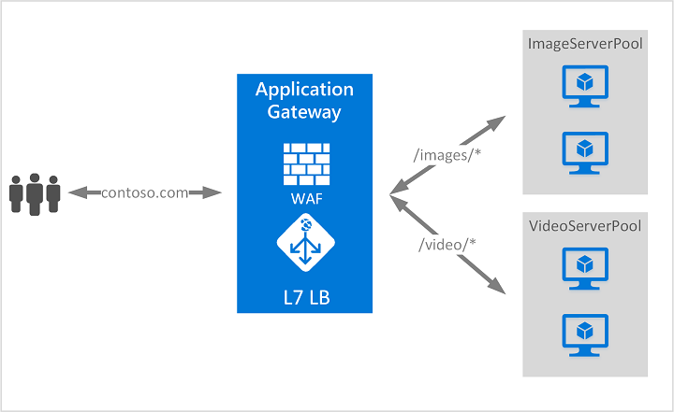

Azure Application Gateway
Layer 7 load balancing
URL path-based
Host based/multiple site hosting with wildcard support
Round robin
Session affinity
Redirection
Header rewrite
URL rewrite
Websocket & HTTP/2 traffic
Connection draining
Custom error pages
Notes:
Centralized SSL offload
Integrated WAF protect you from OWASP attacks

Slide 13
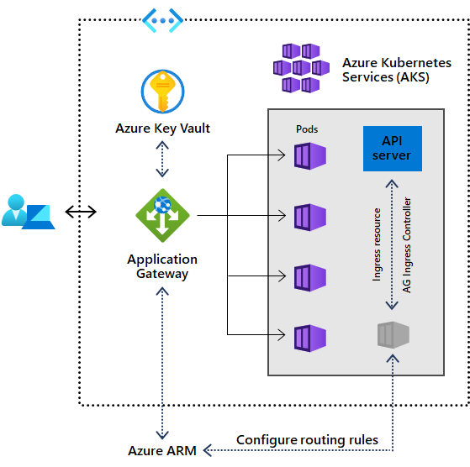
Ingress Controller with AKS
Application Gateway Ingress Controller
Performance benefits over in-cluster ingress controllers
Can be deployed through:
Helm
AKS add-on
AKS add-on allows for one line deployment of:
Cluster
Add-on
Application Gateway
Add-on is a fully managed way to integrate native L7 load balancing with AKS

Slide 14
AGIC Features
Supports Azure CNI and kubenet Network Plugins
Supports Azure and Calico Network Policies
Integrated WAF on Application Gateway
Horizontal Pod Autoscaling support
Support mix of VMs and AKS clusters behind the Application Gateway
HTTP/HTTPS/HTTP2/WebSockets frontend support
Notes:
Grafana supports Azure Monitor, which allows the metrics from Azure/AppGW to import to Grafana

Slide 15


AGIC Benefits
AGIC allows Application Gateway direct communication to AKS pods
Separate compute resources for processing traffic
One line deployment of AGIC add-on via Azure CLI
Fully supported by Microsoft
Integration with Grafana and Prometheus

Slide 16
AGIC use cases
Deployed through Helm:
Multi-cluster to 1 Application Gateway (through ProhibitedTargets)
Multiple AGICs per cluster to 1 Application Gateway
Deployed through add-on:
Currently 1 AGIC per cluster per Application Gateway

Slide 17
Installing AGIC Add-On Greenfield

Slide 18
Set up Azure CLI
az extension add --name aks-preview
Install preview extension on Azure CLI
az feature register --name AKS-IngressApplicationGatewayAddon --namespace Microsoft.ContainerService
Register AGIC add-on feature flag – only once per subscription while in preview
az provider register --namespace Microsoft.ContainerService
Refresh registration of Microsoft.ContainerService resource provider

Slide 19
Set up Resource Group + Deploy AGIC
az group create --name myResourceGroup1 --location eastus
Create a Resource Group
az aks create -n myCluster -g myResourceGroup1 --network-plugin azure --enable-managed-identity -a ingress-appgw --appgw-name myApplicationGateway --appgw-subnet-cidr "10.2.0.0/16" --generate-ssh-keys
Deploy new:
AKS cluster with AGIC add-on enabled
Application Gateway configured by AGIC add-on

Slide 20
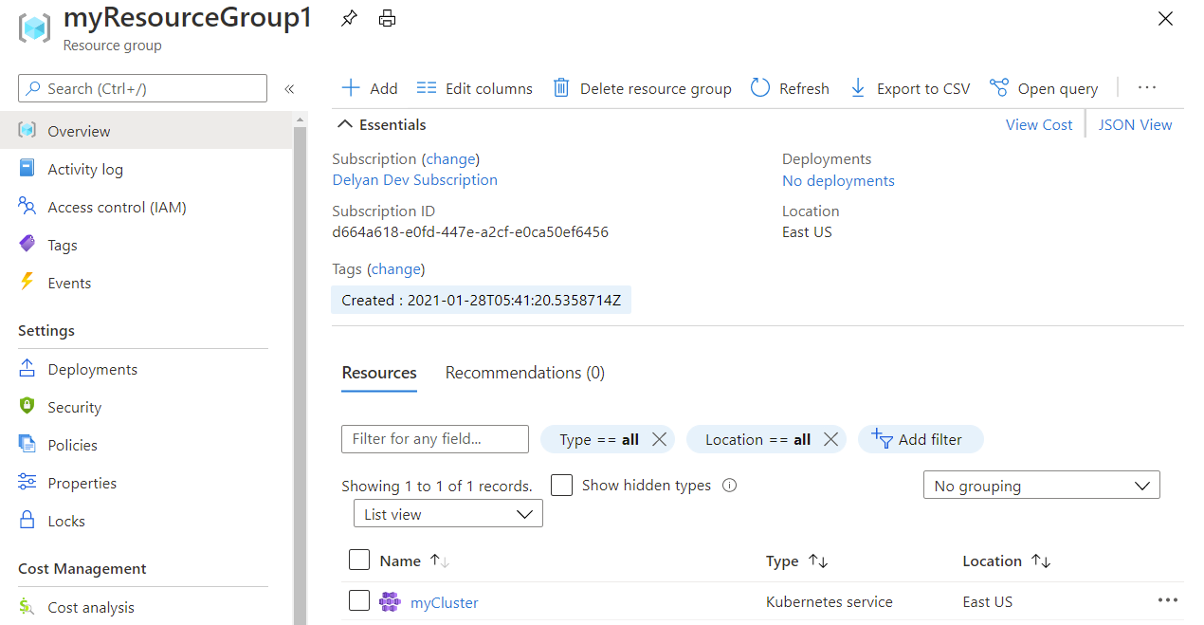

Slide 21
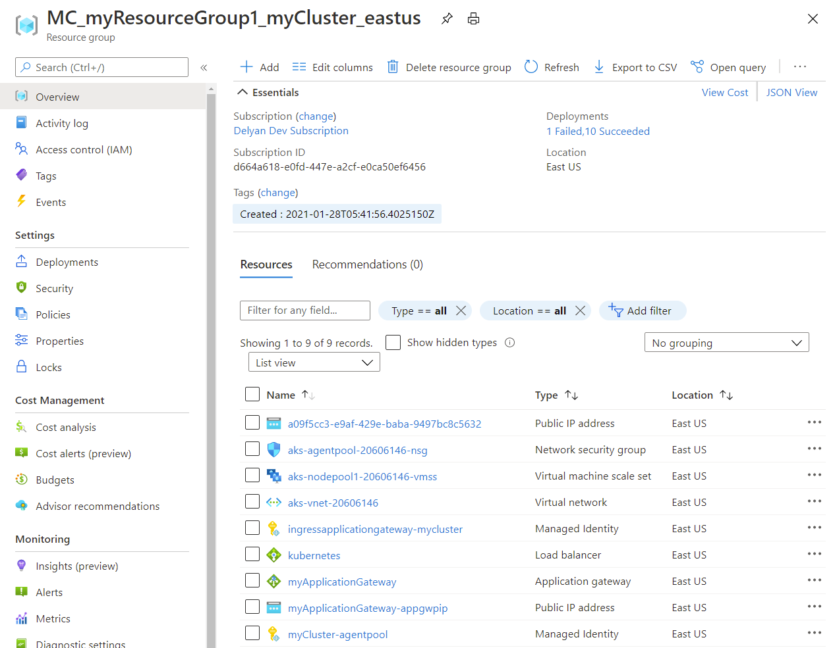

Slide 22
Deploy an Application
az aks get-credentials -n myCluster -g myResourceGroup1
Get credentials of your cluster
kubectl apply -f https://raw.githubusercontent.com/Azure/application-gateway-kubernetes-ingress/master/docs/examples/aspnetapp.yaml
Deploy a sample application on the cluster
kubectl get ingress
Check IP matches frontend IP of Application Gateway

Slide 23
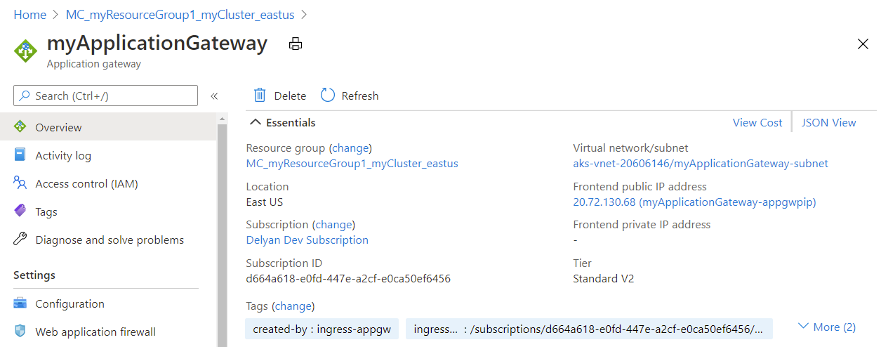

Slide 24
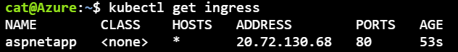
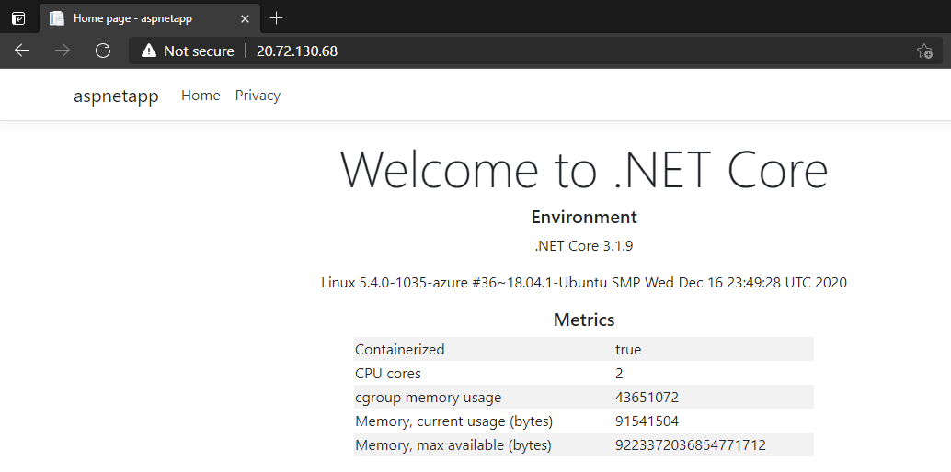

Slide 25
Roadmap
AKS Add-on GA
Header rewrite + URL rewrite parity
Faster updates (AKS updates applied to AppGW)
Release 1.4.0 coming soon
GitHub: aka.ms/agic/github
Roadmap: aka.ms/agic/roadmap
Documentation: aka.ms/aks/agic

